Slide 1
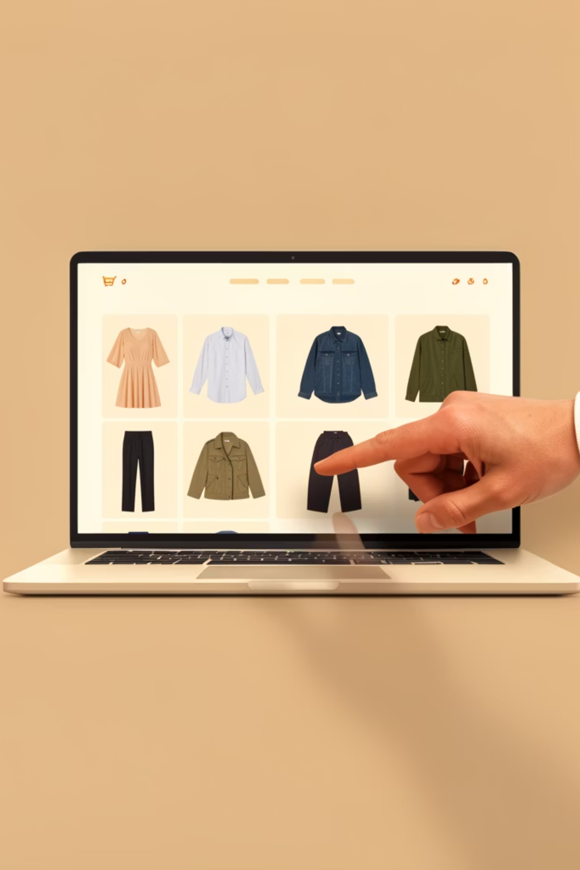
Fashion Hub
CRUD Web Application Deployed using Docker
Submitted By :- Mahak Nigam
Cloud Computing (PBEL Program)

Slide 2
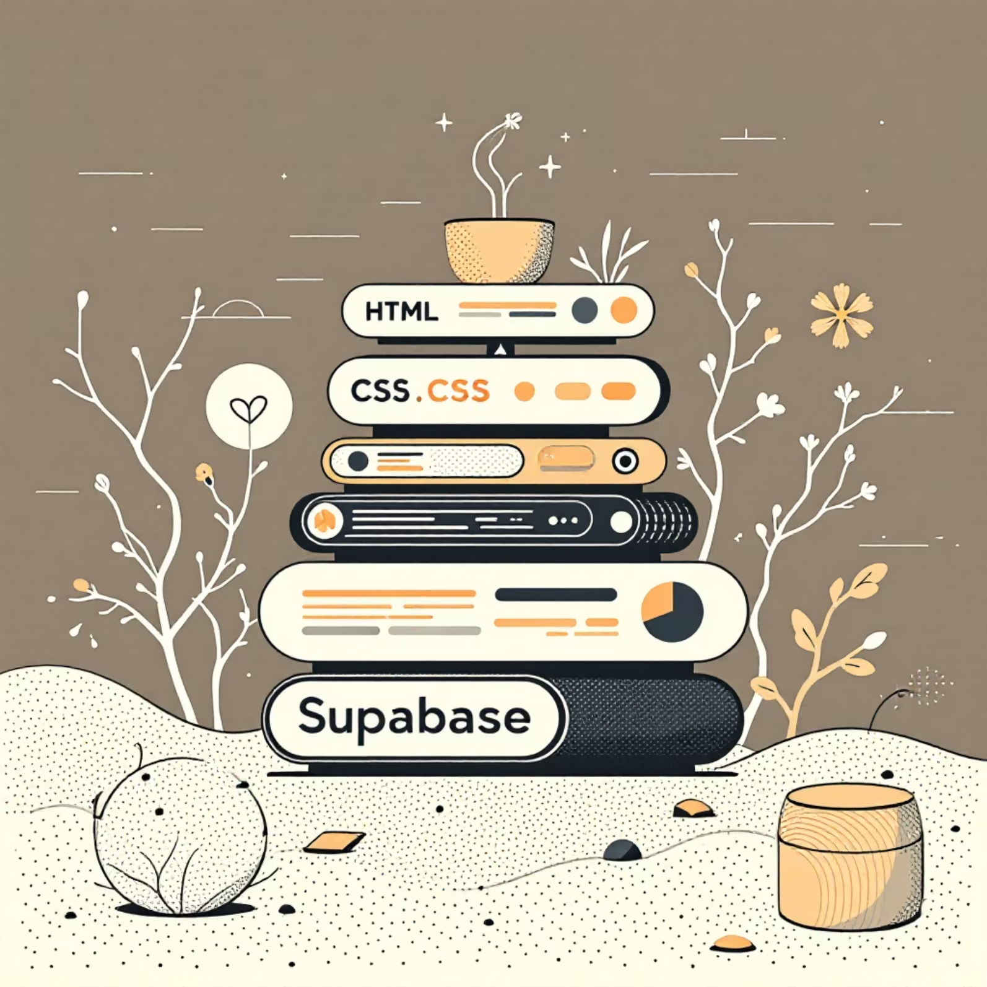
Technology Stack
HTML: Markup language for structure
CSS: Styling and responsive design
JavaScript: Client-side interactivity and logic
Supabase: Open-source Firebase alternative with PostgreSQL backend
Local host server
Docker: Containerization platform for packaging and deploying applications

Slide 3
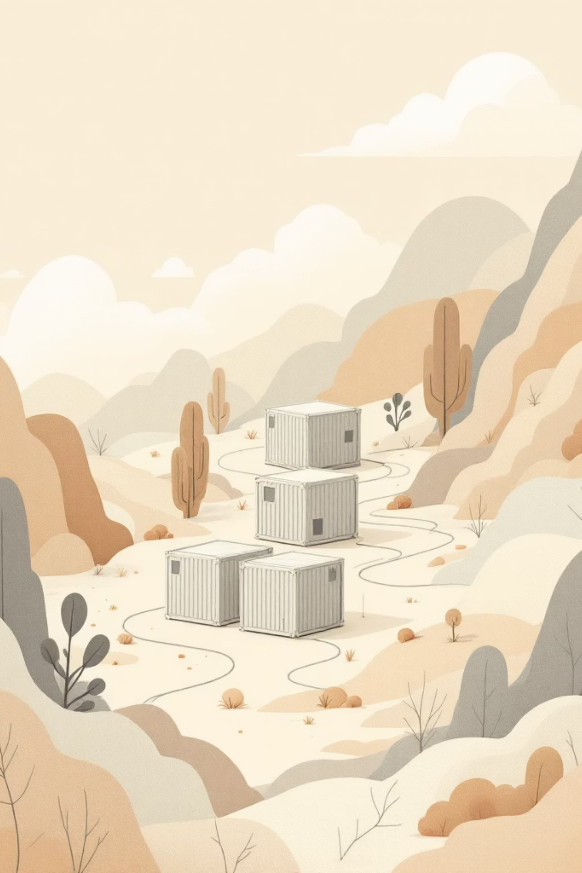


Why Containerize:- Running instance of image
What is Docker?
Docker is a tool used to run applications in isolated environments called containers.
What is Image?
Imagine a container as a small box that contains everything needed for a software to run: Code, Libraries, Dependencies
What is Docker Hub?
Online store to download images

Slide 4
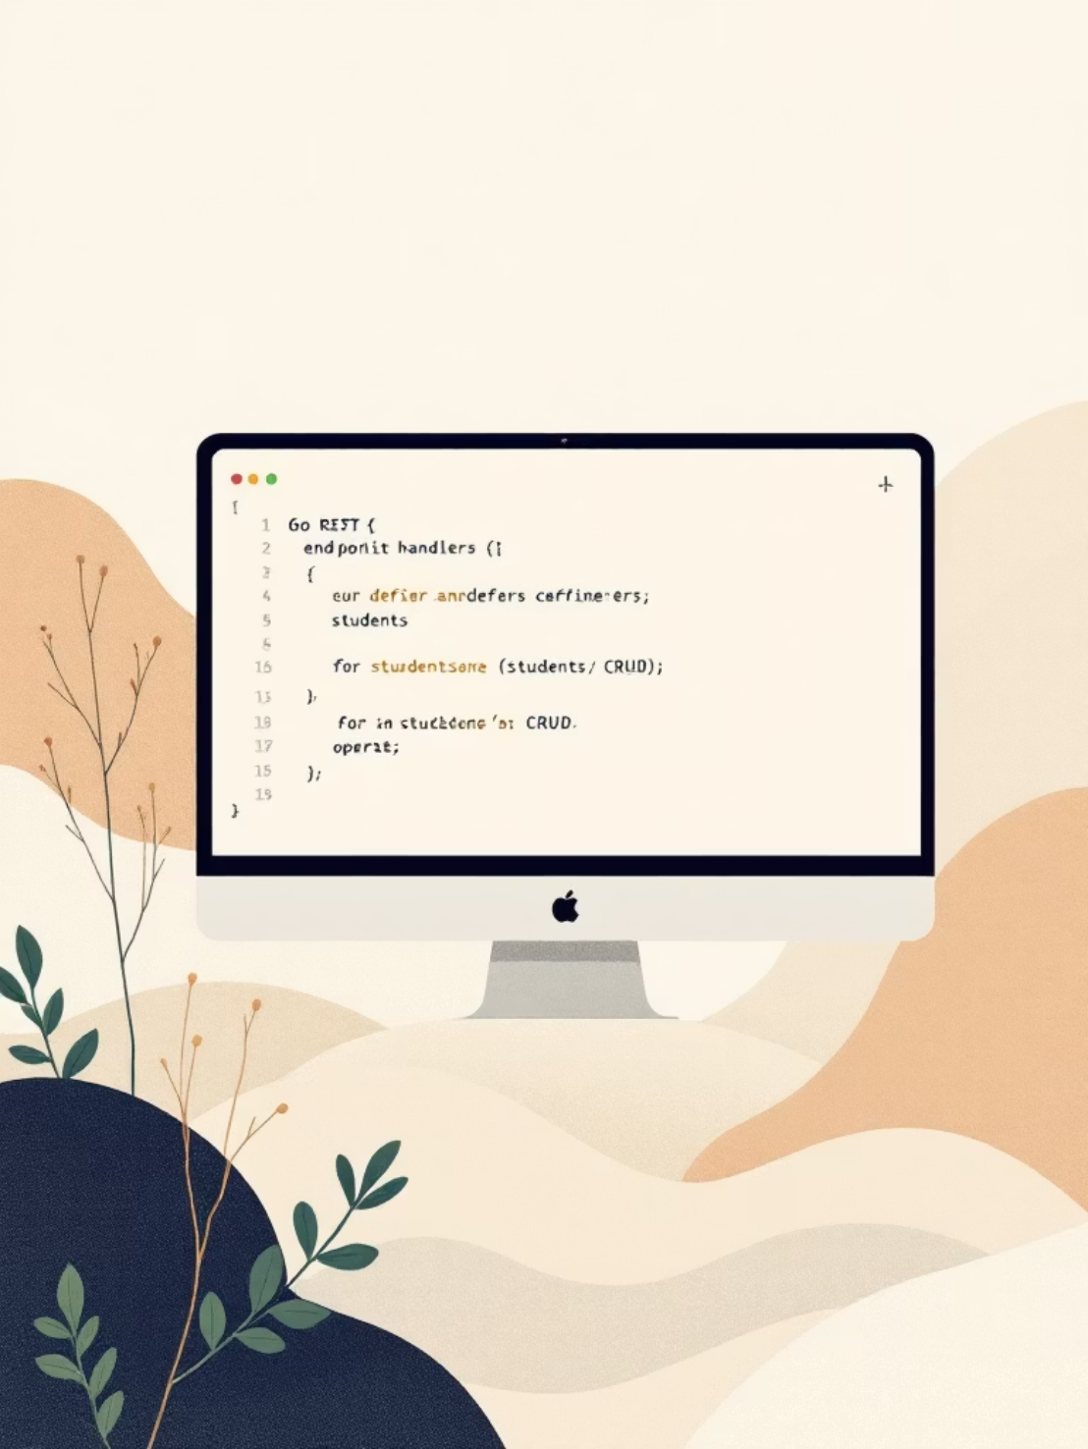
Step 1 — Build & Dockerize the CRUD App
Essential Docker steps
Choose a minimal base image (e.g., golang:1.20-alpine or scratch for compiled binaries).
Copy source, run build, set a non-root user, and EXPOSE the service port.
Build locally and in CI: docker build -t myapp:v1 . then docker run -p 8080:8080 myapp:v1.
Include a health endpoint ( /health ) and readiness probe for orchestration.

Slide 5
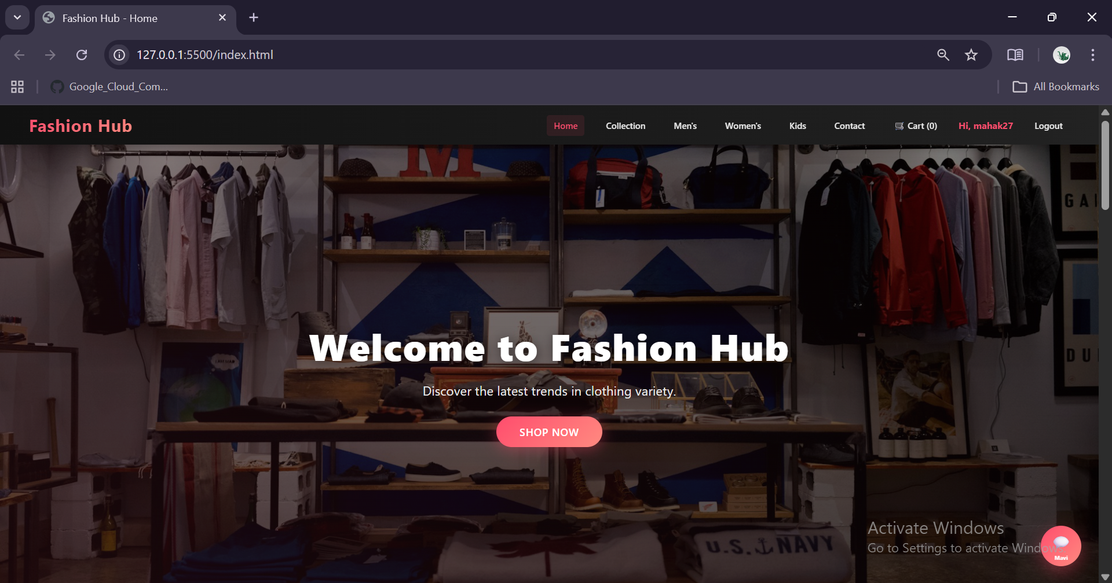
Web Application

Slide 6
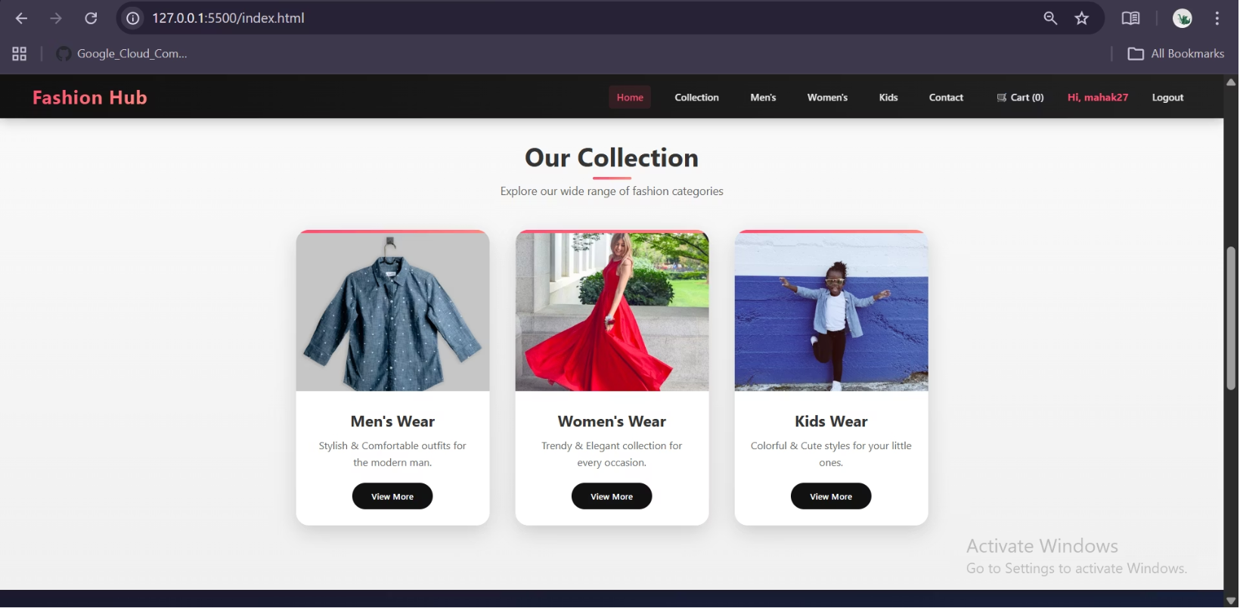
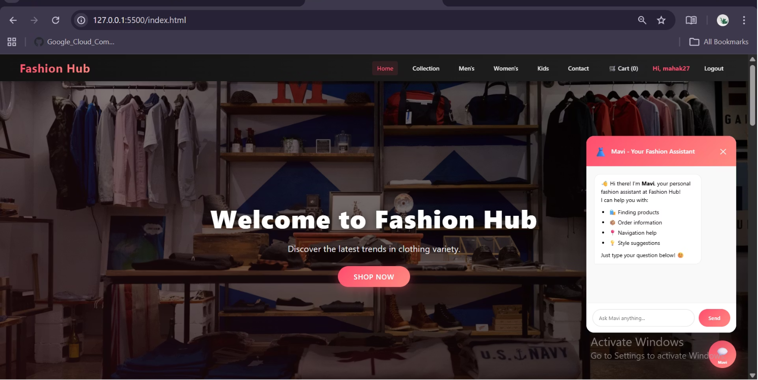

Slide 7
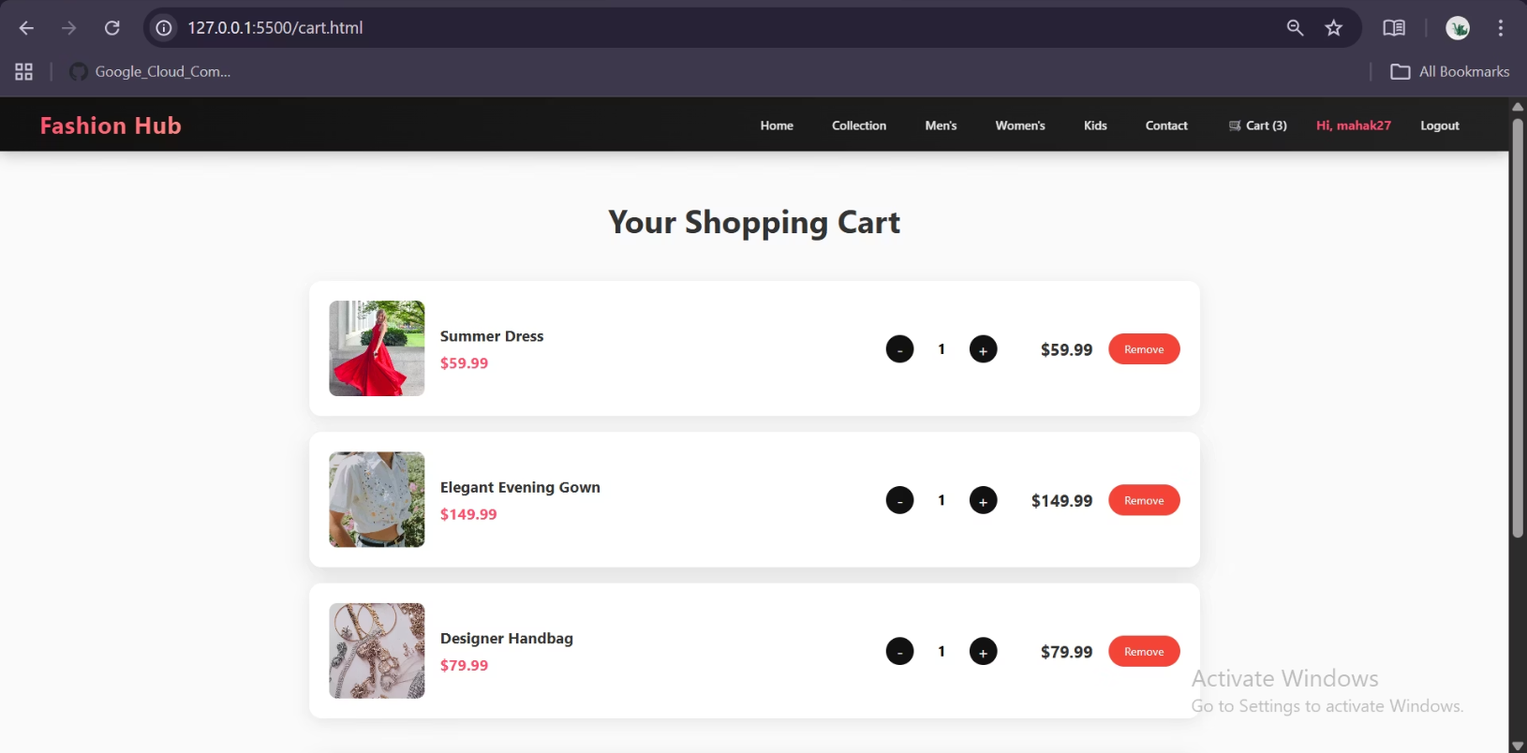
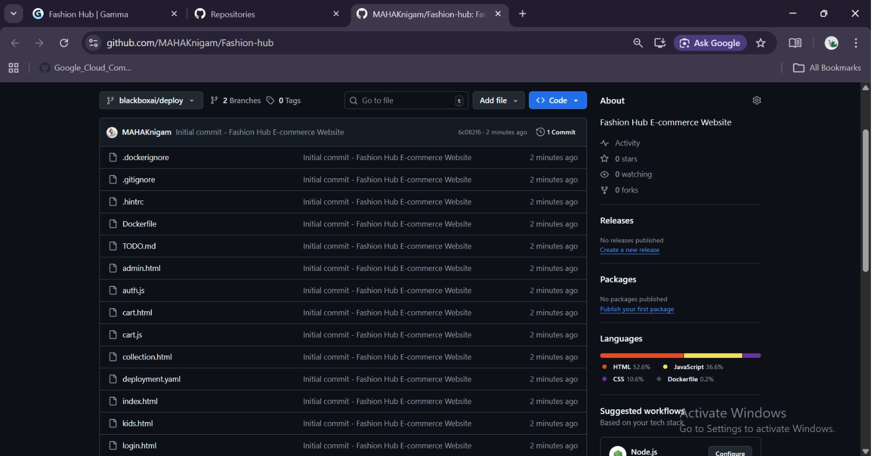

Slide 8
Fashion Hub Credentials
Image ID -28bcf21c2b3a
Container ID :- 2605023caca7e7d28a14419b8d480206670c0ba0330d3db29dc573603d62c773
GitHub link :- https://github.com/MAHAKnigam/Fashion-hub
Docker run –t 3000:3000 docker-website
Docker push dockerhubusername/docker-website
docker build -t my-docker-website .
docker tag my-docker-website <your-username>/my-docker-website:v1
Docker login
Build Docker Image

Slide 9

Thank You!

